Slide 1

Duration: 4 min
The Pieces
The Animation
The Reflection
Computer Graphics
Final – Fire Animation
Nathan Colosimo

Slide 2
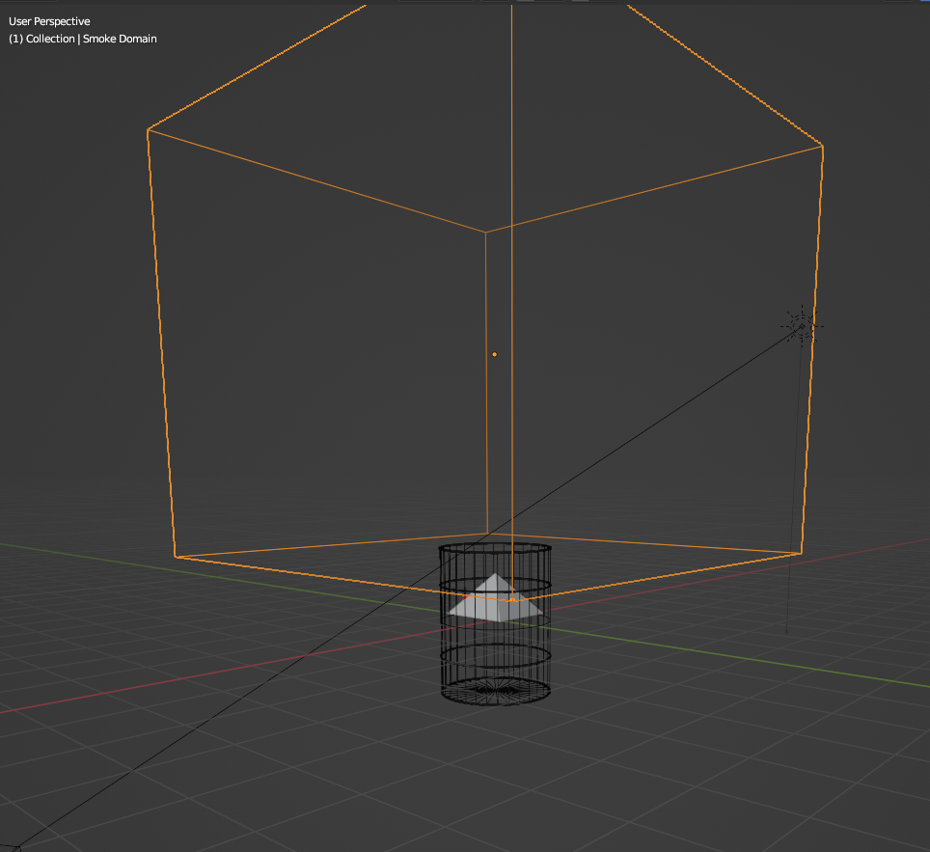
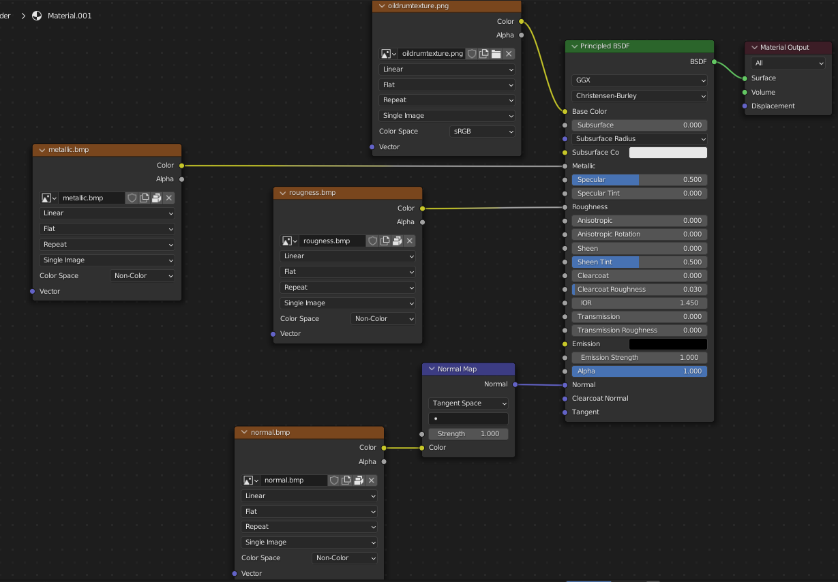
Fire and…
Fire is cool and all, but a good fire is the cause of something burning
The few “easy” steps to creating an oil drum..
Cylinder
Change to a triangle fan cap fill
Cut it in half and mirror the only remaining half for… half the work!
Edges, bevel tool, bevel tool, bevel tool…
Originally settled for a simple oil drum, realized that I there’s other kinds of waste in the world, ones that theoretically burn cooler

Slide 3
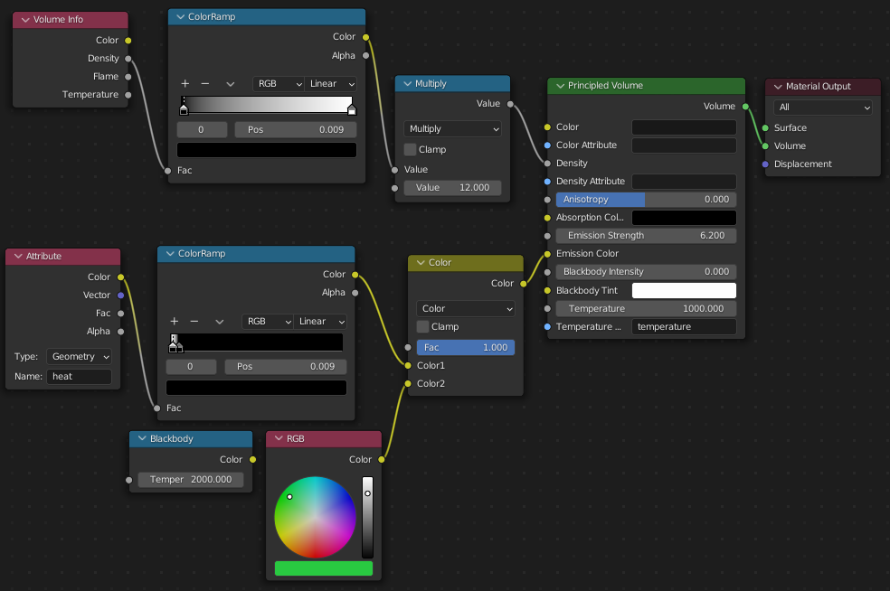
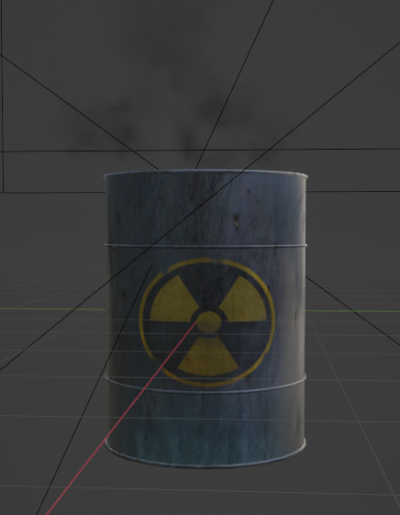
Burning Nuclear Waste?!
Particle Animation Saves The Day!
By using a modified cube, particles are emitted from the faces of the cube
To further randomize particle spread, the emitting cube is placed low enough for the occasional particle out of 4000 to bounce off the inside on its way out, changing its trajectory
After going through the process of setting up the smoke domain, particle properties, and cylinder properties, it was time to bake.
After running through the baking process way too many times (so many lost hours), there was finally a good enough run to move into adding the shader nodes seen above, changing our fire’s properties from colorless gas to nuclear.

Slide 4
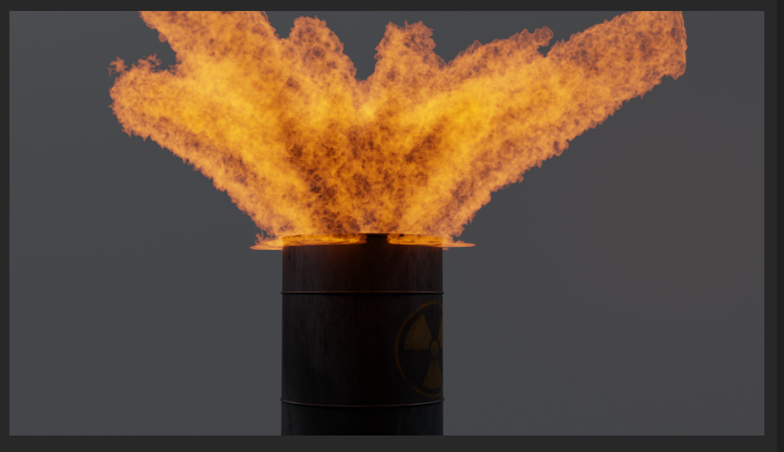
The Initial Render

Slide 5
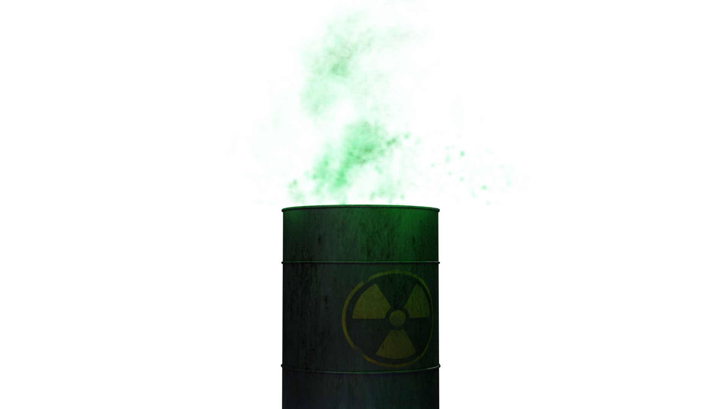
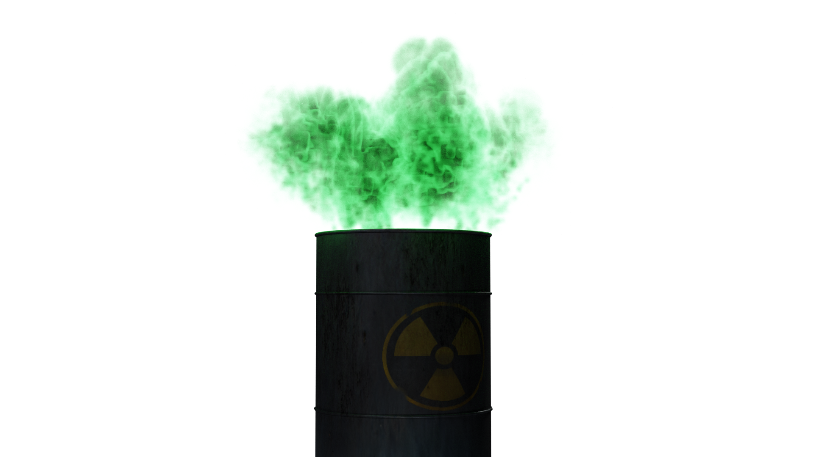
The Better Render

Slide 6
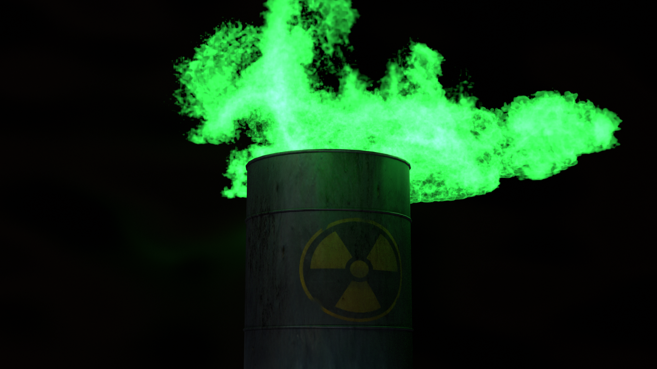
The Best Render

Slide 7
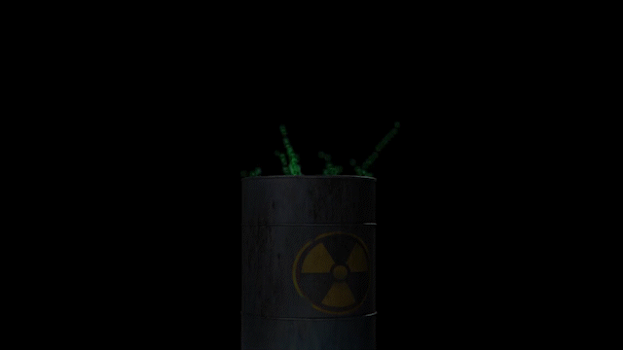
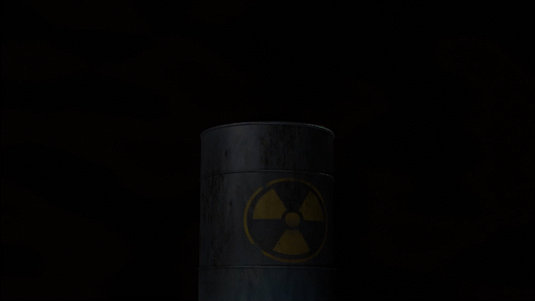
The Animation

Slide 8
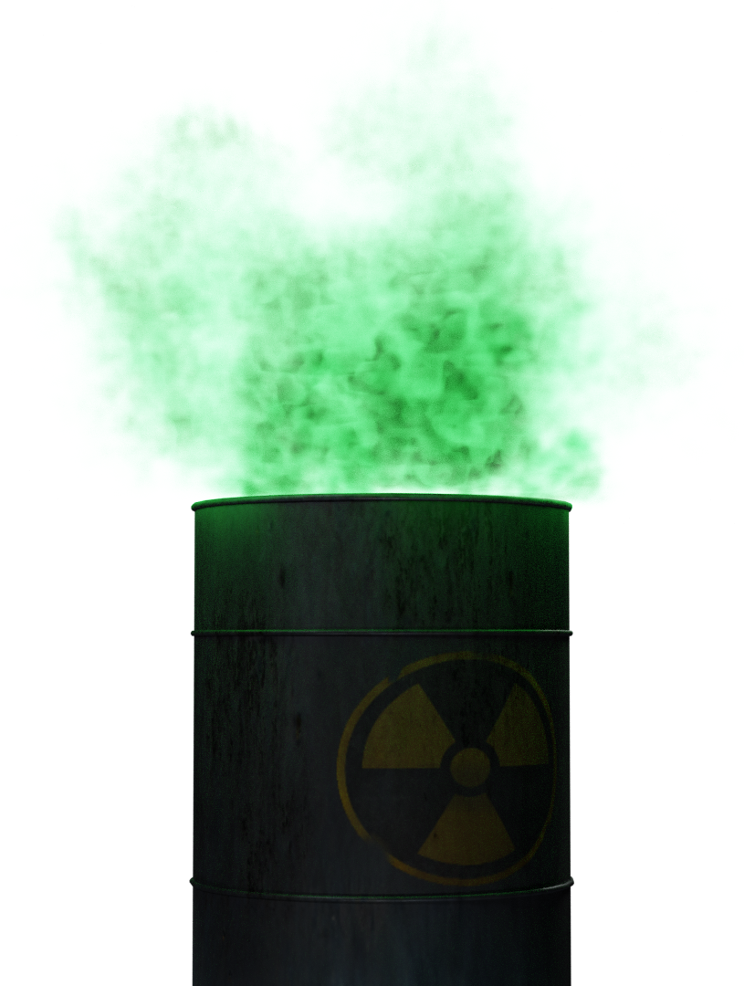
Reflection
Time Spent: Too Much
With the final bake + render taking roughly just over 24 hours (I don’t know why either), I wish I had the capacities to mess with the particle/smoke resolution some more
Additionally, the time it takes the fire to “explode” compared to dying out should be much faster, something that can be looked at in my journey moving forward
I’m extremely happy that this is a project that I took on, despite not having a whole lot of direction in the beginning. Being able to creatively adjust was fantastic
Posting a few more digital trees for all the digital pollution caused by this project
Thank You

